Slide 1
Parking Spot Detection
Ankita Bhageshwar
Akhila K
Harsha Salgunan
Jiya Jacob
Bhargavi Latha

Slide 2
introduction
Objective of the project is to facilitate vision based parking spot detection
Monitoring the status (occupied or empty)of each and every spot in the lot and collect the necessary data to alert the driver.
Solutions will fall into two categories
- Infrastructure based ones
- Software based ones
~ Free spaced based ones
~ Parking slot marking based ones

Slide 3
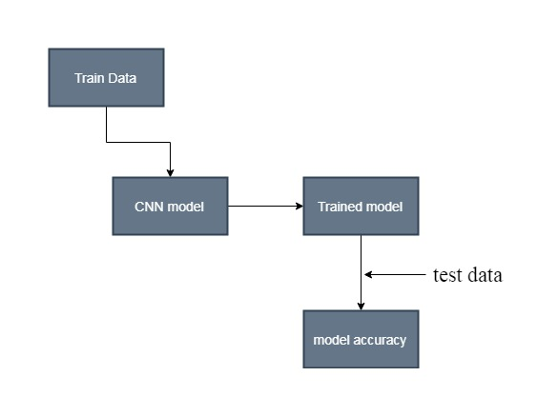
TRAINING THE CNN MODEL

Slide 4
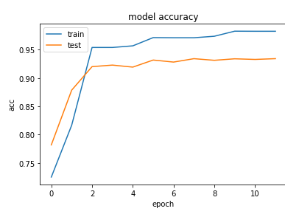
MODEL TRAIN USING CNN

Slide 5
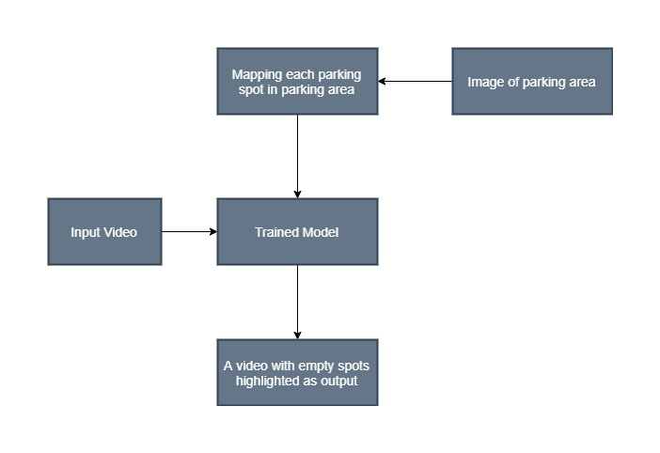
TESTING WITH REAL TIME VIDEO

Slide 6
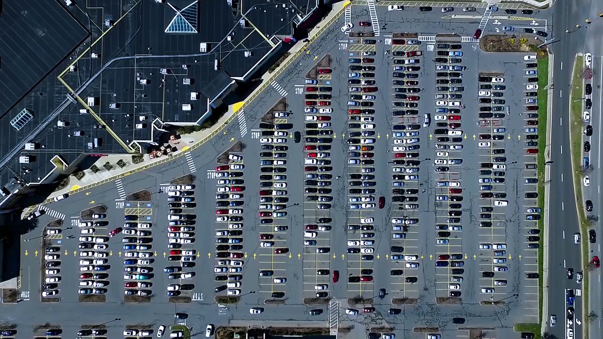
IMAGE OF PARKING LOT

Slide 7
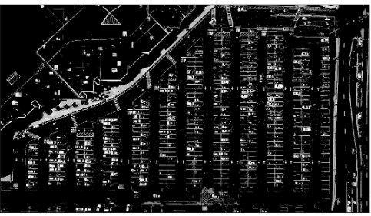
CONVERT TO GRAY SCALE

Slide 8
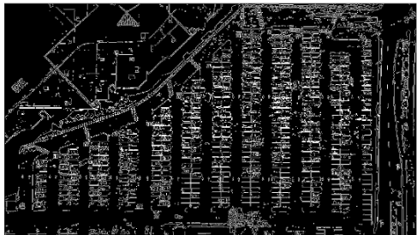
Canny EDGE DETECTION

Slide 9
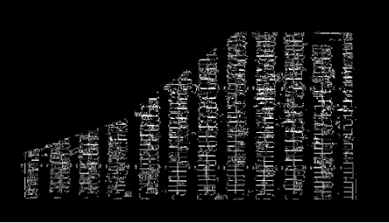
IDENTIFYING AREA OF INTEREST

Slide 10
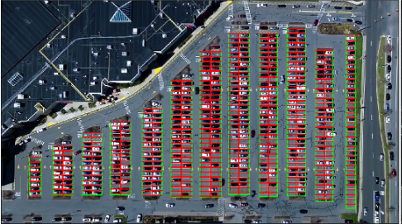
IDENTIFYING THE PARKING SLOTS

Slide 11
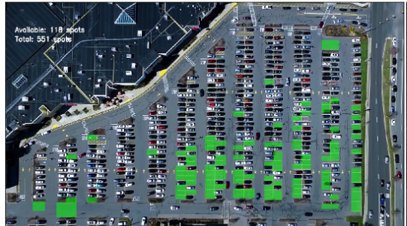
PARKING SPOTS DETECTED

Slide 12
CONCLUSION
A lot more adds on can be made onto this project like we can take climatic conditions, variations in lighting etc can be taken into considerations.
This project can be used for wide applications referring to any open parking slots, thereby an idea of a app can be considered where that app can say the user where exactly he can find the empty slot to park his car.

Slide 13
THANKYOU

